Slide 1
Relationship between Occupational Injury Probability and Risk Perception in Industry Committee Update Meeting 2022 Yenny Fariñas Diaz
Department of Environmental Health Sciences
Robert Stempel College of Public Health and Social Work

Slide 2
Committee Members
Committee Member | Department
Dr. Roberto Lucchini, Professor Major Professor (Committee Chair) | Dept. of Environmental Health Sciences
Dr. Jeremy Chambers, Ph.D, Assistant Professor Director of Doctoral Programs, Department of Environmental Health Sciences Committee Member | Dept. of Environmental Health Sciences
Dr. Shanna L. Burke, MSW, LCSW, PhD, Assistant Professor Committee Member | Dept. of School of Social Work
Dr. Deodutta Roy, PhD, Professor Committee Member | Dept. of Environmental Health Sciences
Dr. Emir Veledar, Ph.D., Courtesy Graduate Faculty Appointment Director of Biostatistics and Predictive Analytics at Baptist Health Committee Member | Dept. of Biostatistics

Slide 3
Background
Understanding risk perception and the associated human behaviors are key in understanding how individuals react to hazards and how a culture of safety is developed. In order to understand this perception we first need to be able to model and classify injuries and fatalities across industry.
Our belief is that within an industry and relative to other industries, the number of injuries and fatalities will average to a value a given industry over time. These values can be formulated into a mathematical equation, that can be subsequently used to calculate the inherent injury and fatality probability for a given industry.
A secondary data analysis of documented workplace injuries for over nine hundred (900) occupations within an eight (8) year period is being conducted. The analysis will examine the correlation of injury and fatalities for each given industry.
A model will be developed to represent if a relationship exists between industry, gender, age, and race in relation to Fatalities/Injuries.
The general intent of the study is to model injury and fatality rates across industry over time, do these rates collapse into a known equation that can be used to predict injury and fatality rates.

Slide 4
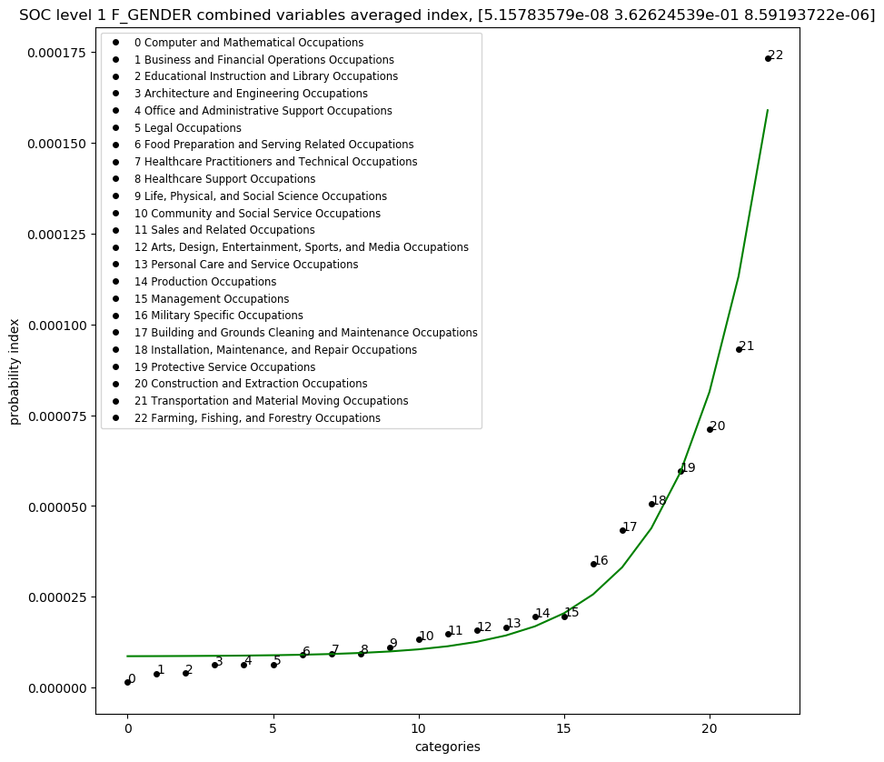
Hypothesis
Fatality and Injury prediction
We hypothesize that occupational rates of injury and fatalities over time average to a known value, and these known values can be projected into a model of calculated probabilities that can be used to determine an ultimate combined probability.
A final model will be created, such that the probability of fatality(PF) or injury(PI) can be predicted based on the following variables: occupation, gender, age, race, and length of service.
P_{fatality} = PF _{gender} (occupation) * PF _{age} (occupation) * PF _{race} (occupation)
P_{injury} = PI _{gender} (occupation) * PI _{age} (occupation) * PI _{race} (occupation)
probability
occupation
Figure 1: Graphical Representation of Hypothesis.

Slide 5
Innovative contribution:
In our analysis we assigned each industry a known integer value. The job categories were sorted based on fatality and injury rates. Our assertion is that this structure will not change over time, and that an industry's inherent risk(injury/fatality) is constant. Thereby allowing it to be used as a measure of risk. This measure of injury or fatality risk will be used to calculate an overall probability of fatality or injury over time.
Subsequently, a nonlinear regression for the data collected will be performed. All regressions will yield three values A,B,C which fit the following equation:
Probability = A * e^{(B*X)} + C, where X is the integer value selected for a given occupation.
A final model will be created, such that the probability of fatality(PF) or injury(PI) can be predicted based on the following variable: occupation, gender, age, race, and length of service.
P_{fatality} = PF _{gender} (occupation) * PF _{age} (accupation) * PF _{race} (occupation)
P_{injury} = PI _{gender} (occupation) * PI _{age} (accupation) * PI _{race} (occupation)

Slide 6
Specific Aims
Aim1: (Occupational Risk)
To examine the likelihood that occupational risk for a given industry can be predicted by using an equation that calculates a given probability for injury or fatality.
Will evaluate:
What the effect of variables such as: Length of service, Age, Gender, Race, Injury Event has on fatalities and injuries.
Aim 2: (Risk Perception)
To examine the correlation of injury on fatalities and fatalities on injuries. Is this due to a risk perception or just part on an inherent effect.
Will evaluate:
if there is a correlation between occupational injuries and fatalities given any type of occupation.

Slide 7
DATA STORAGE

Slide 8
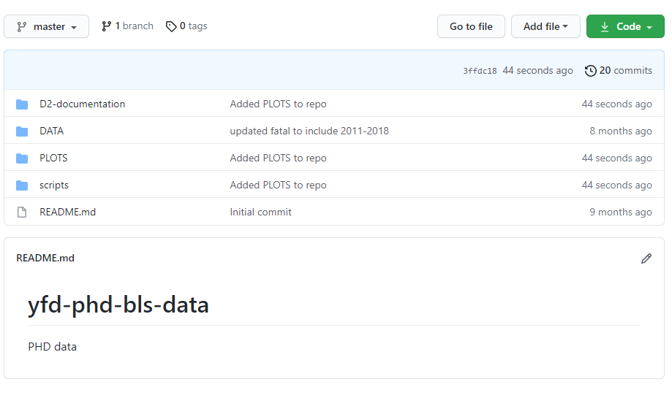
Data Repository Location
https://github.com/ehsintegration/yfd-phd-bls-data
All DATA is kept in the GITHUB depository located in the link above.
The SCRIPTS folder contains the analysis and (RESULTS) for each variable where the graphs are also embed and located within the program itself, or within the PLOTS directory.
DATA
PLOTS
SCRIPTS
Figure 2: GITHUB repository location.

Slide 9
POPULATION SIZE

Slide 10
Approach: Sample Population and Sample Size
Sample population:
A total of 8 years of Injury, Illness and Fatalities data from the United States Department of labor from 2011 through 2018 in Private Industry in the United States.
The injury and fatality data is representative of various private sector industries reported to the United States Department of labor, of which all will be used for this study.
This study only analyses those injuries deemed to be recordable or resulting in a fatality.
A recordable injury is defined by the Occupational Safety and Health Administration (OSHA) recordkeeping standard in the Code of Federal Regulations as a fatality or “Any work-related injury or illness that results in loss of consciousness, days away from work, restricted work, or transfer to another job. Any work-related injury or illness requiring medical treatment beyond first aid” (OSHA, 29 C.F.R.§1904.7 Subpart C, 2001).
Required Sample size:
Alpha levels were set at 0.05 (95% confidence level), with a 5% margin of error, therefore requiring a population size of a minimum of 385.
Our analysis in the GIT repository, shows that the collected data points in the study exceeds the required sample size of 385.

Slide 11
DATA OVERVIEW

Slide 12
Data Overview
The data collected is publicly available as these industries are subject to reporting their injuries, illnesses and fatalities to their corresponding state once an employee has incurred a recordable case and annually to the US Department of Labor Bureau of Labor Statistics.
Data availability: The data will be retrieved from Federal databases from the US Department of Labor (U.S. Bureau of Labor Statistics, 2020).
Multi-screen data search (2011-2018): https://www.bls.gov/iif/data.htm (U.S. Bureau of Labor Statistics, 2020).
Data collected and converted to CSV format was stored at : https://github.com/ehsintegration/yfd-phd-bls-data/tree/master/DATA
Copyrights, publications, licensing and data protection, : https://www.bls.gov/opub/ (U.S. Bureau of Labor Statistics, 2020).
Licensing: The data retrieved from “Data.gov” can be used without cost or a licensing requirement.
Copyrights, publications: The Bureau of Labor Statistics requests that they be cited when the data is used.
Data protection: The data is protected in an official site “Data.gov” from the US Government and it complies with Computer Fraud and Abuse Act of 1986 and the National Information Infrastructure Protection Act. The data integrity of the injured or deceased employee has already been protected by the collecting entity.
Notes:
Converting to CSV format was a challenging process.

Slide 13
Data Overview
SOCJOBCODE
For our proposed risk analysis, we will be:
Obtained fatality and workplace injury data from the department of US Labor Statistics.
Collected data for over for over nine hundred (900) occupations within an eight (8) year period.
We have one (1) dataset for all FATAL counts for each SOC job code. (Fatalities are expressed as totals and not per category due to the Department of Labor data repository).
We also have multiple datasets for different INJURY counts by categories of: GENDER, AGE, LENGTH OF SERVICE, RACE and TYPE OF INJURY EVENT.
The SOCJOBCODE:
Is a numerical categorical classification system, that is used to encode the occupational type. It is encoded such that it can also be used as an independent variable.
It is a six-digit number, where the numeric place value implements an administrative encoding.
The numerical range of this encoding is also enumerated in increasing risk order, where the job classifications at the higher value range represents occupations with a lower degree of administrative type work but higher risk jobs.
Administrative
(Lower risk jobs)
11-XXXX Management Occupations
13-XXXX Business and Financial Operations Occupations
15-XXXX Computer and Mathematical Occupations
17-XXXX Architecture and Engineering Occupations
19-XXXX Life, Physical, and Social Science Occupations
21-XXXX Community and Social Service Occupations
23-XXXX Legal Occupations
25-XXXX Educational Instruction and Library Occupations
27-XXXX Arts, Design, Entertainment, Sports, and Media Occupations
29-XXXX Healthcare Practitioners and Technical Occupations
31-XXXX Healthcare Support Occupations
33-XXXX Protective Service Occupations
35-XXXX Food Preparation and Serving Related Occupations
37-XXXX Building and Grounds Cleaning and Maintenance Occupations
39-XXXX Personal Care and Service Occupations
41-XXXX Sales and Related Occupations
43-XXXX Office and Administrative Support Occupations
45-XXXX Farming, Fishing, and Forestry Occupations
47-XXXX Construction and Extraction Occupations
49-XXXX Installation, Maintenance, and Repair Occupations
51-XXXX Production Occupations
53-XXXX Transportation and Material Moving Occupations
55-XXXX Military Specific Occupations
Non-Administrative (Higher risk jobs)
Figure 3: SOC level 1 risk profile.

Slide 14
Data Overview: Analysis (Occupation Type: SOC Standard Occupational Classification)
Each SOC job category number is used to encode a branch of occupation. The SOC job code consists of 6 numbers, that when read from left to right will further subdivide the group into more specifications. The job code is used to denote a location in a TREE of occupations.
11-0000 Management Occupations
11-1000 Top Executives
11-1010 Chief Executives
11-1011 Chief Executives
11-1020 General and Operations Managers
11-1021 General and Operations Managers
11-1030 Legislators
11-1031 Legislators
11-2000 Advertising, Marketing, Promotions, Public Relations,
and Sales Managers
11-2010 Advertising and Promotions Managers
11-2011 Advertising and Promotions Managers
11-2020 Marketing and Sales Managers
11-2021 Marketing Managers
11-2022 Sales Managers
11-2030 Public Relations Managers
11-2031 Public Relations Managers
11-3000 Operations Specialties Managers
11-3010 Administrative Services Managers
11-3011 Administrative Services Managers
11-3020 Computer and Information Systems Managers
.
.
.
.
.
11-9140 Property, Real Estate, and Community AssociationManagers
11-9141 Property, Real Estate, and Community Association Managers
11-9150 Social and Community Service Managers
11-9151 Social and Community Service Managers
11-9190 Miscellaneous Managers
11-9199 Managers, All Other
13-0000 Business and Financial Operations
13-1000 Business Operations Specialists
13-1010 Agents and Business Managers of Artists, Performers, and Athletes
13-1011 Agents and Business Managers of Artists, Performers, and Athletes
13-1020 Buyers and Purchasing Agents
13-1021 Purchasing Agents and Buyers, Farm Products
13-1022 Wholesale and Retail Buyers, Except Farm Products
13-1023 Purchasing Agents, Except Wholesale, Retail, and Farm Products
13-1030 Claims Adjusters, Appraisers, Examiners, and Investigators
13-1031 Claims Adjusters, Examiners, and Investigators
13-1032 Insurance Appraisers, Auto Damage
13-1040 Compliance Officers, Except Agriculture, Construction, Health and Safety, and Transportation
13-1041 Compliance Officers, Except Agriculture, Construction, Health and Safety, and Transportation
13-1050 Cost Estimators
13-1051 Cost Estimators
13-1060 Emergency Management Specialists
13-1061 Emergency Management Specialists
13-1070 Human Resources, Training, and Labor Relations
.
.
(https://github.com/ehsintegration/yfd-phd-bls-data/blob/master/DATA/SOC_all.xlsx)
The following file contains all the standard occupational coding that is used to index the data (all SOC codes).

Slide 15
Data Overview: Analysis (Occupation Type: SOC Standard Occupational Classification)
11-XXXX Management Occupations
13-XXXX Business and Financial Operations Occupations
15-XXXX Computer and Mathematical Occupations
17-XXXX Architecture and Engineering Occupations
19-XXXX Life, Physical, and Social Science Occupations
21-XXXX Community and Social Service Occupations
23-XXXX Legal Occupations
25-XXXX Educational Instruction and Library Occupations
27-XXXX Arts, Design, Entertainment, Sports, and Media Occupations
29-XXXX Healthcare Practitioners and Technical Occupations
31-XXXX Healthcare Support Occupations
33-XXXX Protective Service Occupations
35-XXXX Food Preparation and Serving Related Occupations
37-XXXX Building and Grounds Cleaning and Maintenance Occupations
39-XXXX Personal Care and Service Occupations
41-XXXX Sales and Related Occupations
43-XXXX Office and Administrative Support Occupations
45-XXXX Farming, Fishing, and Forestry Occupations
47-XXXX Construction and Extraction Occupations
49-XXXX Installation, Maintenance, and Repair Occupations
51-XXXX Production Occupations
53-XXXX Transportation and Material Moving Occupations
55-XXXX Military Specific Occupations
SOC Level 1 – Cumulative Count
The X’s represent a don’t care condition. Which means it is a wildcard that represents all possible values.
XXXX-mask
This XXXX-mask nomenclature represents a cumulative count for all sublevel occupations within that structure.
Our mathematical analysis scripts parse all of the sublevel occupations and groups them to obtain a final count for the complete group.
Figure 3: SOC level 1 risk profile.

Slide 16
Data Analysis: Example of SOC Tree Branch
Here is an example of the TREE encoding system, with further descendant selectivity. The “X”s below can be viewed as a don’t care.
The occupational code is a 6 different number that clusters occupations into finer and finder resolutions.
Therefore a occupational index of “23XXXX” will select all “legal occupations”
And a occupational index of “231XXX” will select all “lawyers, judges, and related workers”
And a occupational index of “231011” will select all “lawyers”
Administrative
11-XXXX Management Occupations
13-XXXX Business and Financial Operations Occupations
15-XXXX Computer and Mathematical Occupations
17-XXXX Architecture and Engineering Occupations
19-XXXX Life, Physical, and Social Science Occupations
21-XXXX Community and Social Service Occupations
23-XXXX Legal Occupations
25-XXXX Educational Instruction and Library Occupations
27-XXXX Arts, Design, Entertainment, Sports, and Media Occupations
29-XXXX Healthcare Practitioners and Technical Occupations
31-XXXX Healthcare Support Occupations
33-XXXX Protective Service Occupations
35-XXXX Food Preparation and Serving Related Occupations
37-XXXX Building and Grounds Cleaning and Maintenance Occupations
39-XXXX Personal Care and Service Occupations
41-XXXX Sales and Related Occupations
43-XXXX Office and Administrative Support Occupations
45-XXXX Farming, Fishing, and Forestry Occupations
47-XXXX Construction and Extraction Occupations
49-XXXX Installation, Maintenance, and Repair Occupations
51-XXXX Production Occupations
53-XXXX Transportation and Material Moving Occupations
55-XXXX Military Specific Occupations
We can also see that the numbering system increases in a numerical order, in proportionality to human physical manual difficulty.
Non-Administrative
Figure 3: SOC level 1 risk profile.

Slide 17
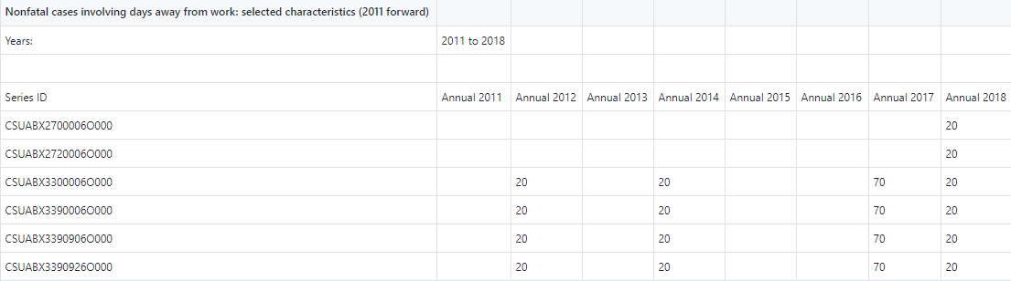
All the data was collected from the US department of Labor and uploaded to a GITHUB repository. A series of Jupyter python programs was created to parse the data for analysis. The data is stored as individual files for each independent variable:
In each file you will find eight sample values for each SOC job category, as shown below:
Data Overview: Methodology (file structure)
Independent Variables → | Age | Gender | Length of Service | Race
Type of Variable → | Categorical Continuous | Categorical | Categorical Continuous | Categorical
 | NF_AGE_14to15_all.xlsx NF_AGE_16to19_all.xlsx NF_AGE_20to24_all.xlsx NF_AGE_25to34_all.xlsx NF_AGE_35to44_all.xlsx NF_AGE_45to54_all.xlsx NF_AGE_55to64_all.xlsx NF_AGE_65plus_all.xlsx NF_AGE_NR_all.xlsx | NF_GENDER_F_all.xlsx NF_GENDER_M_all.xlsx NF_GENDER_NR_all.xlsx | NF_LOS_ltg3mos_all.xlsx NF_LOS_3to11mos_all.xlsx NF_LOS_1to5yr_all.xlsx NF_LOS_5plus_all.xlsx NF_LOS_NR_all.xlsx | NF_RBX_Asian_all.xlsx NF_RDX_Hispanic_all.xlsx NF_REX_Hawaiian_all.xlsx NF_RFX_White_all.xlsx NF_RGX_NR_all.xlsx NF_RHX_Multi_all.xlsx NF_RIX_Hispanic_all.xlsx NF_RCX_Black_AfricanAmerican_all.xlsx NF_RAX_AmericanIndian_AlaskaNative_all.xlsx
Figure 4: File name and content structure.
Notes:
Shows the data files. How it looks like and how the files correlates to the variables.

Slide 18
MODEL

Slide 19
Approach: Dependent and Independent Variables
Summary of Variables:
Dependent Variable: 1 main outcome variable of interest is probability of injury/fatality.
Independent variables of interest: 4 (occupation, gender, age, race).
Table 1
Dependent and Independent Variables
Dependent Variables (Risk) (Derived from job encoding) | Types of Variables
Probability of Injury/Fatality (Derived from job encoding) | Continuous
Independent Variables (Risk Perception) (Occupational Recordable Injury, Illnesses and Fatalities for each) | Types of Variables
Age | Categorical
Gender, Race | Categorical
Occupation | Categorical
Note: Might have to flip my graphs so that Risk Perception is on the X axis and Risk is on the Y axis.
Artificial system was created for Risk ranging from (0.0 to 22.0). We took the enumerated categories and turned it into a real number ranging from (0.0 to 22.0).
Notes:
Might have to flip my graphs so that Risk Perception is on the X axis and Risk is on the Y axis.
Artificial system was created for Risk ranging from (0.0 to 22.0).
We took the enumerated categories and turned it into a real number ranging from (0.0 to 22.0).

Slide 20
Approach: Description of Independent Variables
Table 2a
Description of Independent Variables
Independent Variables → | Age | Gender | Race | Occupation Type
Type of Variable → | Categorical Continuous | Categorical | Categorical | Categorical
 | 14-15 Yrs.' 16-19 Yrs.' 20-24 Yrs.' 25-34 Yrs.' 35-44 Yrs.' 45-54 Yrs.' 55-64 Yrs.' 65 Yrs.' + Not Reported | Male Female Not Reported | Asian African American/Black (non-Hispanic) Hispanic/Latino White Multi Race | Life Scientists Biological Scientists Medical Scientists Physical Scientists Chemists & Material Scientists Chemists Biological Technicians Chemical Technicians Health Technologists & Technicians Clinical Laboratory Technologists & Technicians Medical & Clinical Lab Techologists Medical & Clinical Lab Technicians Production Occupations (for Manufacturing)

Slide 21
Approach: Description of Dependent Variables
Table 2b
Description of Dependent Variables
Dependent Variables → | Probability of Injury/Fatality
Type of Variable → | Categorical

Slide 22
Approach: Description of Independent Variables (file names in data repository)
https://github.com/ehsintegration/yfd-phd-bls-data/tree/master/DATA
Table 3
Description of Independent Variables (File List) , list of data files for each variable.
Independent Variables → | Age | Gender | Race
Type of Variable → | Categorical Continuous | Categorical | Categorical
 | NF_AGE_14to15_all.xlsx NF_AGE_16to19_all.xlsx NF_AGE_20to24_all.xlsx NF_AGE_25to34_all.xlsx NF_AGE_35to44_all.xlsx NF_AGE_45to54_all.xlsx NF_AGE_55to64_all.xlsx NF_AGE_65plus_all.xlsx NF_AGE_NR_all.xlsx | NF_GENDER_F_all.xlsx NF_GENDER_M_all.xlsx NF_GENDER_NR_all.xlsx | NF_RBX_Asian_all.xlsx NF_RDX_Hispanic_all.xlsx NF_RFX_White_all.xlsx NF_RGX_NR_all.xlsx NF_RHX_Multi_all.xlsx NF_RCX_Black_AfricanAmerican_all.xlsx

Slide 23
Approach: Model
Data Selector/
Equation
---2011
---2012
..
---2018
---2011
---2012
..
---2018
---2011
---2012
..
---2018
Fatality Data
Injury Data
(used for model creation)
Scientist:
191000 Life Scientist
191020 Biological Scientist
192030 Chemist Scientist
.
.
Laboratories:
292010 Clinical Laboratory
292011 Medical Laboratory
.
.
Independent Variables
Age
Gender
Race
Production:
113050 Production Managers
435060 Production Clerks
510000 Production Occupations
.
.
Probability of Injury/Fatality
Dependent Variable (Risk)
Figure 5: Risk Perception Model.

Slide 24
MATHEMATICAL OVERVIEW

Slide 25
Mathematical Summary: Overview
Now that we are familiar with the data files and their contents, we can further explore the type of data collected and the reasoning behind it.
In our analysis we are creating a single averaged value for each of the eight years, for each SOC job code. This averaging helps to determine the mean value for each occupation. This mean will be used as a variable for the final calculation of probability. The probability for each classification will be multiplied together in otder to obtain a final probability of injury or fatality for the given independent variables.
Where X is the occupational integer number, and A,B,C are the given coefficients for a linear regression.
Probability _{(Gender or age or race)} = A * e^{(B*X)} + C
P_{fatality} = PF _{gender} (occupation) * PF _{age} (occupation) * PF _{race} (occupation)
P_{injury} = PI _{gender} (occupation) * PI _{age} (occupation) * PI _{race} (occupation)
Notes:
Take all the jobs and collapsed them together.
For each SOC code, averaged the age years into one value, then took the averaged fatality and divided by the averaged injury for that specific SOC code.

Slide 26
Mathematical Summary: Rationale
Reason why the log function was used:
Risk Perception_{logvalue} = -1 * LOG10 [ AVG(FATAL_COUNT / INJURY_COUNT) ]
The reason why we selected to take the log, is because the data is exponential in nature and when you take the log of exponential data, you create a semi-log plot, now the exponential data looks linear, which makes it easier to perform a linear regression.
The logarithmic equation above was used for three reasons:
To factor out the total population size:
(FATAL_COUNT / POPULATION_SIZE) / (INJURY_COUNT / POPULATION_SIZE) = FATAL_COUNT / INJURY_COUNT
Fatalities is divided by Injuries in order to eliminate the population size. Because every SOC job code has a different population size, this adjusts the data and makes it independent of population size, making it easier to compare one SOC job code to another.
To create a factor, where the magnitude of the index will demonstrate fatalities normalized to injuries.
To create a risk perception index.
Notes:
Take all the jobs and collapsed them together.
For each SOC code, averaged the age years into one value, then took the averaged fatality and divided by the averaged injury for that specific SOC code.

Slide 27
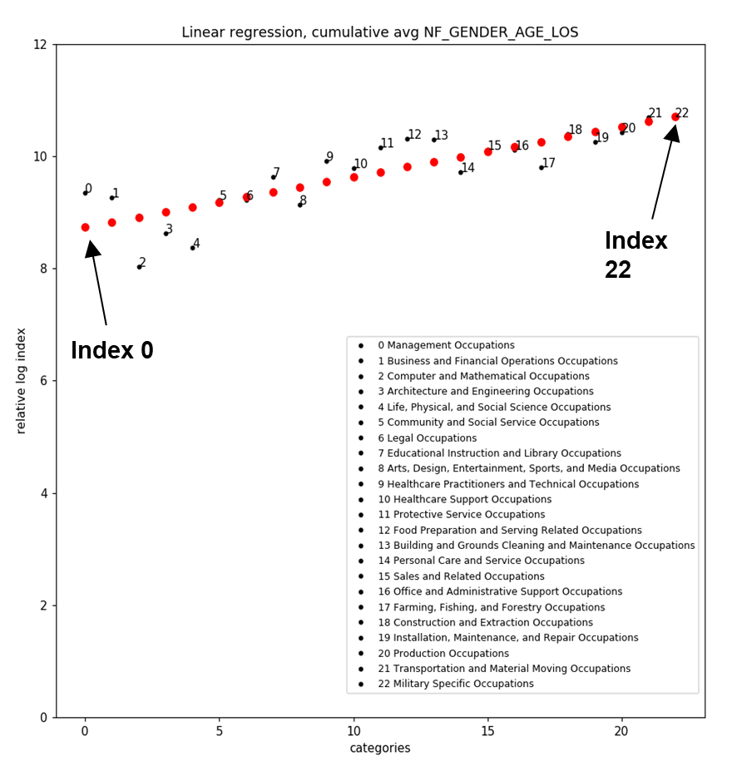
Mathematical Summary: Risk Perception Defined
Fatal risk log factor (risk perception) = RP_{logvalue} = -1 * LOG10 [ AVG(FATAL_COUNT / INJURY_COUNT) ]
The “Fatal risk log factor”, is not only the log of fatalities count divided by injuries count, but also a measure of risk perception.
In our analysis we will end up with a graph that represents risk perception vs a measure of risk. We will use this graph to analyze the overall response of the data.
risk perception
risk
Figure 6: Graphical Representation of Hypothesis with Risk labels.

Slide 28
CURRENT RESULTS

Slide 29
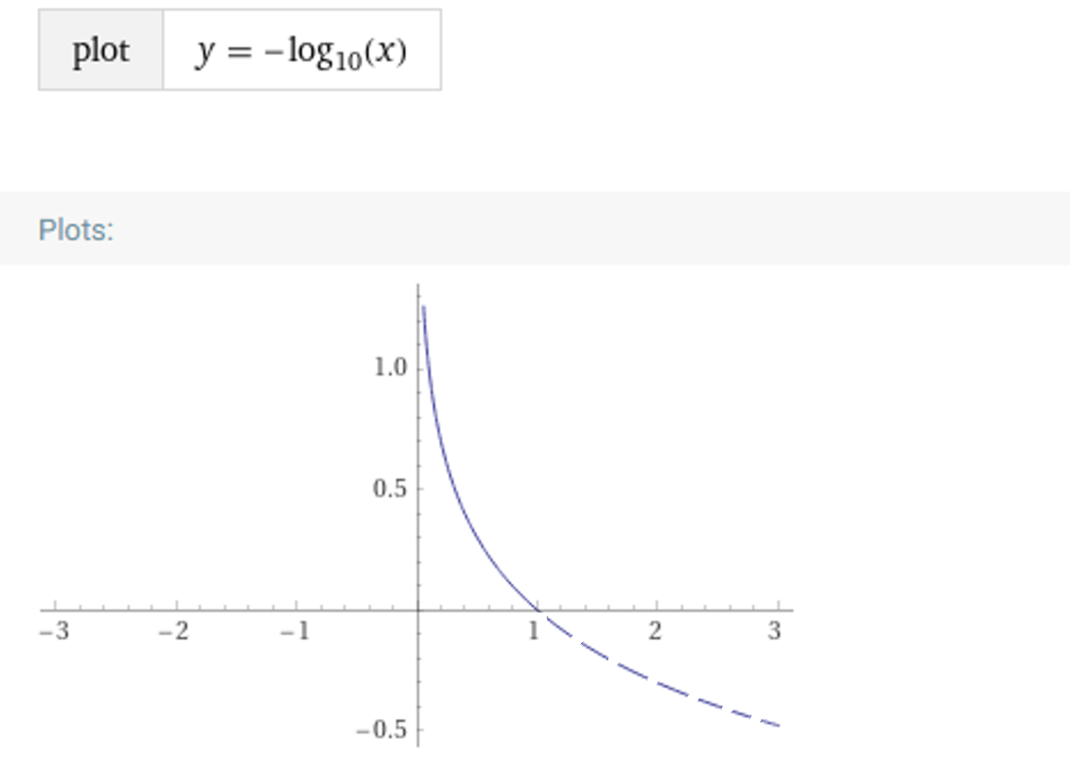
Example Data: F/I -> Risk Perception Conversion Equation
Risk perception index function:
y_{log} = [-1 * log10(y_{data})]
RP_{log} = [-1 * log10(FI_{data})]
The data is being converted to a semi-log plane, so that it forms a linear distribution that can be easily analyzed.
The formula above is how we generate the risk perception index from the fatality/injury rate.
RP_{logvalue}
(risk perception index)
Notes:
F/I on X axis ranges from 0 to 1.
F/I will never be > 1.
When F/I is low, RP is high.
When F/I approaches 1, RP is low.
FI
(rate)
Figure 8: Risk Perception Equation Graph Transfer Example.
Notes:
Fatality/Injury
Never will have an FRO >1
The closer to zero, the higher the Risk Perception. A small fatality will have a high risk perception.

Slide 30
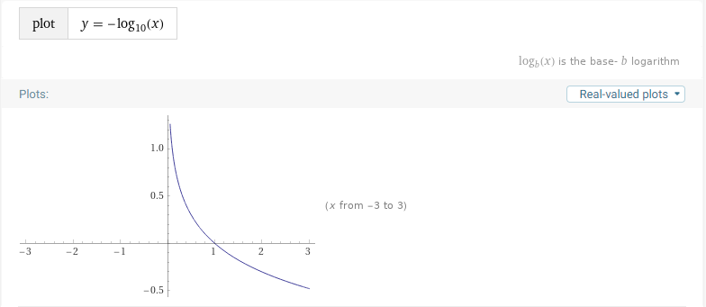
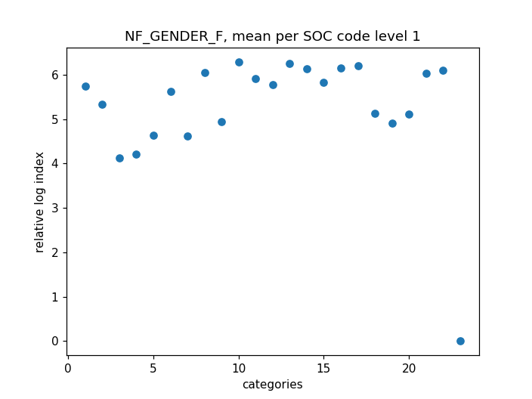
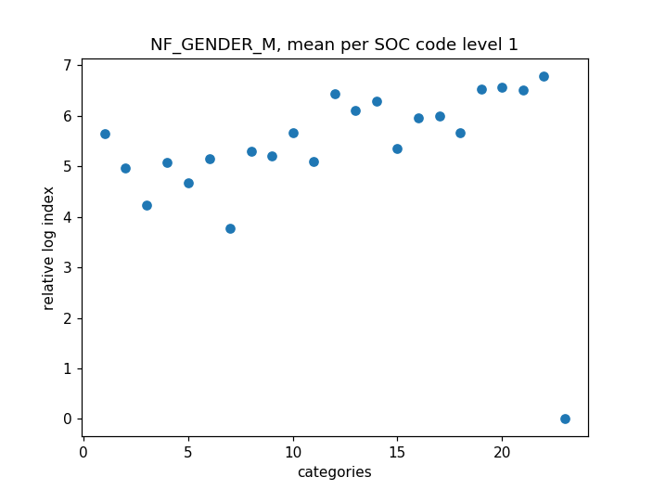
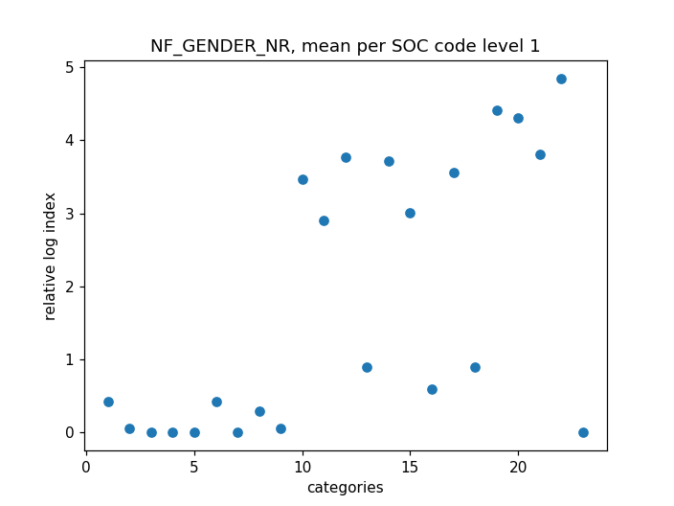
Example Data: SOC level 1 Data for Gender
Since, the relative index is a function of:
RP_{logvalue} = [-1 * log10(FI_{rate})],
then a higher relative log index value, correlates to a smaller fatality/injury rate.
Since the categories on the x axis are ranked from left to right with increasing job risk. We can see a positive slope, that indicates that people with a higher perception of risk have a lower fatality rate.
Figure 9: Risk Perception Equation
risk perception
risk
Figure 9a: Female Averaged Data Distribution
Figure 9b: Male Averaged Data Distribution
Figure 9c: Not reported Averaged Data Distribution

Slide 31
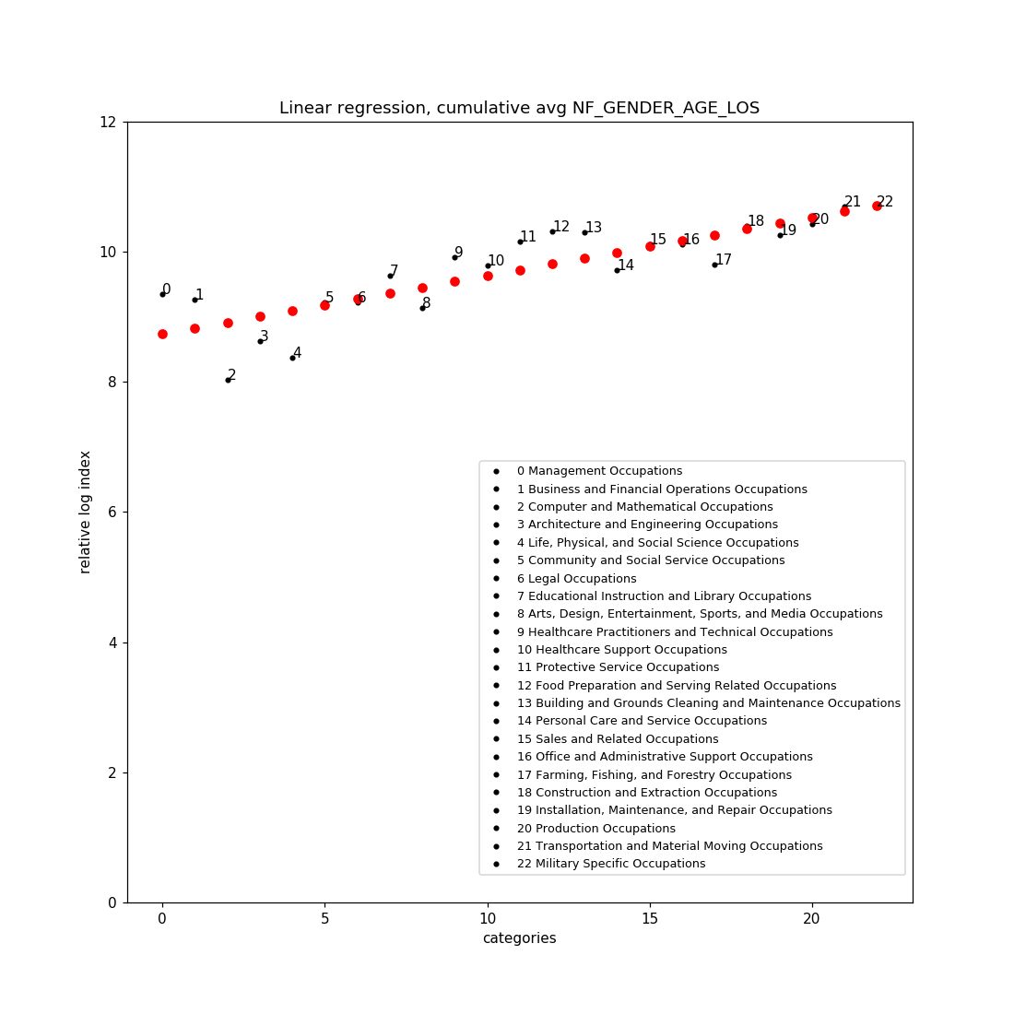
Example Data: Cumulative Averaged Values for GENDER/AGE/LOS, SOC level 1
The graph to the right was created by averaging all the occupational categorical fatality log values. This was done for GENDER, AGE, and LOS (length of service).
RACE also produces a positive slope, however, the correlation of the values to the linear regression, was a better match (better R²) when RACE data was not averaged.
risk perception
risk
Figure 10: Cumulative Averaged Data Regression.
Figure 9: Risk Perception Equation.
Notes:
Greater Risk Perception = less fatalities
Fatalities divided by Injuries --→ Risk perception profile
Higher RP, lower fatality rate
For every F/I we take the log.

Slide 32
Example Data: Conclusion Summary
Since, the relative index is a function of:
y_{log} = [-1 * log10(y_{data})],
then a higher relative log index value, correlates to a smaller fatality/injury rate.
The categories on the x axis are ranked from left to right with increasing job risk. We can see a positive slope, that indicates that people with a higher perception of risk have a lower fatality rate.
The value for index 0 regression, is 8.73 (fatal log index)
The value for index 22 regression is 10.71 (fatal log index)
Since these are log values they are converted with:
FI_{rate} = 10 ^ (-1 * RP_{logvalue})
(To go from RP to FI rate, we have to take the inverse log)
Therefore:
The real FI rate for regression index 0 , is 1.841e-09
The real FI rate for regression index 22, is 1.94e-11 (smaller)
This means that the occupation with the most risk for fatality being Military Specific Occupations, had the smallest real fatality value (highest perception index). The occupation with the least perceived risk, Management Occupations, had the largest real fatality value (lowest perception index).
Index 22
Index 0
risk perception
risk
Figure 11: Indexed Cumulative Averaged Data Regression.

Slide 33
Example Data: Conclusion Summary
FI_Rate_{value} = 10 ^ (-1 * RiskPerception_{logvalue})
The occupation with the least perceived risk, Management Occupations, had the largest real fatality value (lowest perception index).
For index 0 regression:
8.73 (lower risk perception index)
1.841e-09 (largest fatality/injury)
The occupation with the most risk for fatality being Military Specific Occupations, had the smallest real fatality value (highest perception index).
For index 22 regression:
10.71 (higher risk perception index)
1.94e-11 (smallest fatality/injury )
Index 22
Index 0
risk perception
risk
Figure 11: Indexed Cumulative Averaged Data Regression.
Notes:
Why selected the Log Equation used?
Because some data has large values and other small. By taking the log it allows us to look at the data in as a linear distribution.
Then took the anti log in order to convert back to a true (numerical) fatality/injury rate (independent of occupation size).
The X value is risk.

Slide 34
NEXT STEPS

Slide 35
Next Steps
Analysis:
Need further statistical analysis to look at the relationship between the linear regression line and the actual data.
Gather Hours Worked Data.
Race does not have a good distribution, needs further analysis.

Slide 36
Next Steps : Statistical Options Considered
Table 5
Statistical options.
Statistical Analysis Selected | Why | Comments
Pearson’s correlations will be used to determine the relationship between risk exposure and injury. | Measures the association between the variables. Used to measure strength of the association. | Used to find R-Squared.
A univariate linear regression model will be used to investigate the relationship between injury status and individual potential risk factors. | Used to determine single variable relationship between dependent and independent variables. | Single variable regression equation.
A multivariate linear regression model will be used to examine the influence of a combination of risk factors for becoming injured. | Used to determine a multi variable relationship between the independent variables and the dependent. | All variable regression equation.

Slide 37
Next Steps : Statistical Options
Table 5 (cont.)
Statistical options.
Statistical Analysis Selected | Why | Comments
Covariates will be fitted into the model using a forward selection procedure and will retain in the final linear regression model if they reached a statistical threshold of p<0.10 or were of significance. | Begin with no candidate variables in the model. Select the variable that has the highest R-Squared. (from Pearson) Select the candidate variable that increases R-Squared the most. Stop adding variables when none of the remaining variables are significant p<0.10. | Used to find independent variables for the final regression model.
A logistic regression will be used to investigate the relationship between injury severity and possible risk factors. | Can analyze cut offs, binary categories. Example, does having more than 5 years experience a factor, also analyze age cut offs, or gender. | Binary category analysis.
All statistical analysis will be conducted using Jupyter and/or R Studio, which is a data analytics tools that is commonly being used to analyze publicly available data. The data will be pulled from DOL but it will be stored in the Github depository. Bloxplots, data distribution, linear regression were conducted. | https://github.com/ehsintegration/risk-perception Python will help with data acquisition, and R can be used in parallel with python. Jupyter notebook allows for dual usage (R and Python) in a notebook setting. Example: https://github.com/tobywise/covid19-risk-perception | Jupyter’s notebook format models, Mathematica’s notebook style.

Slide 38
INDIVIDUAL PLOTS

Slide 39
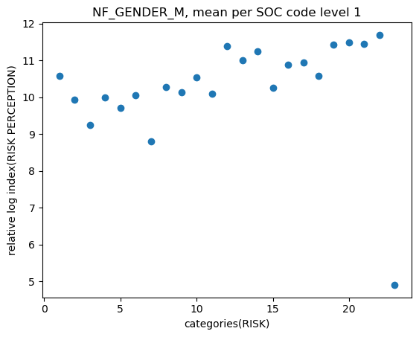
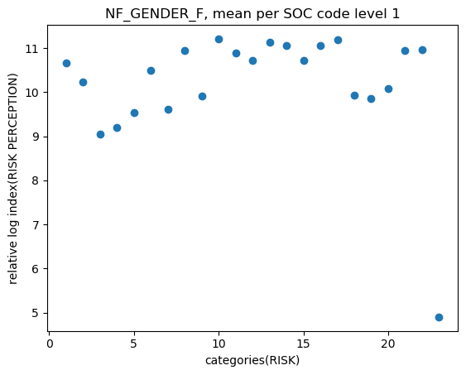
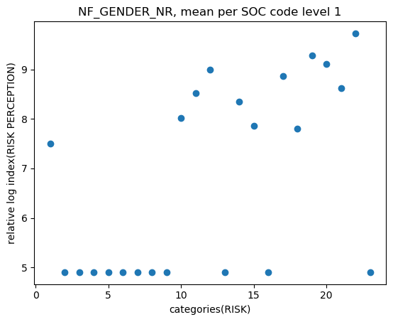
NF_GENDER

Slide 40
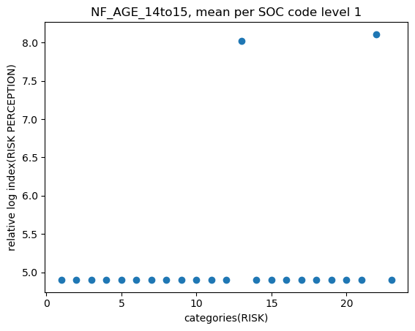
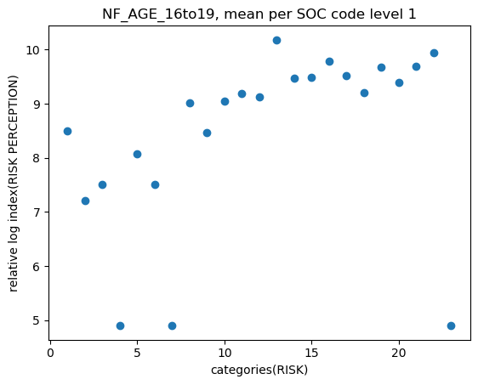
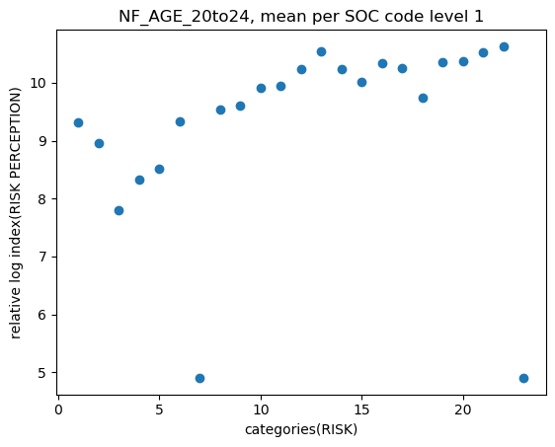
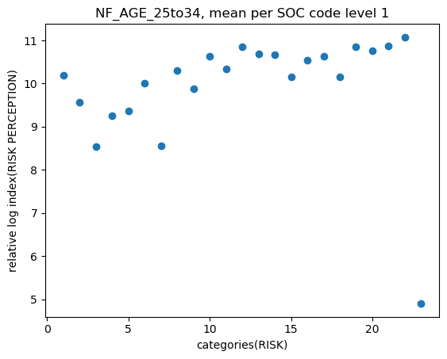
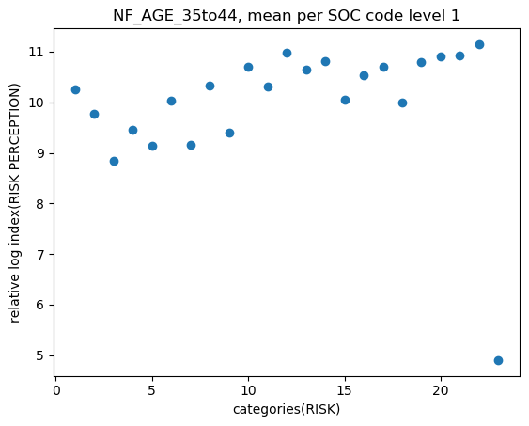
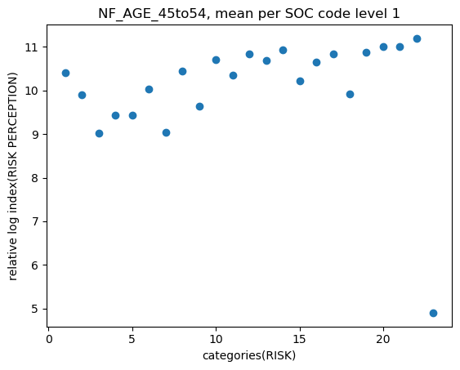
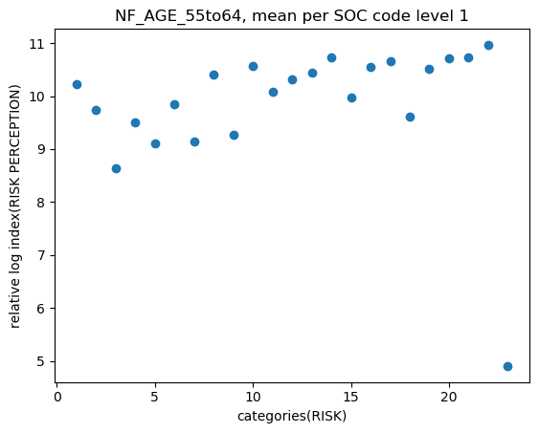
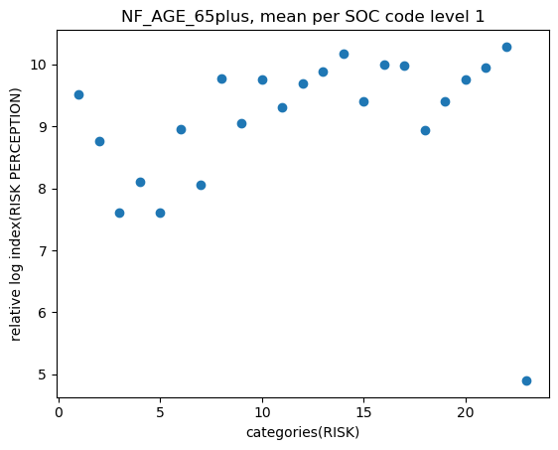
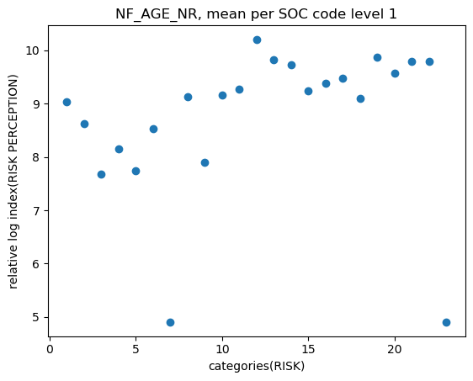
NF_AGE

Slide 41
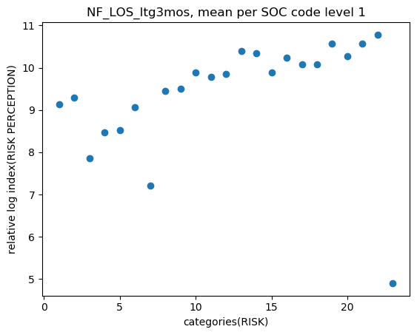
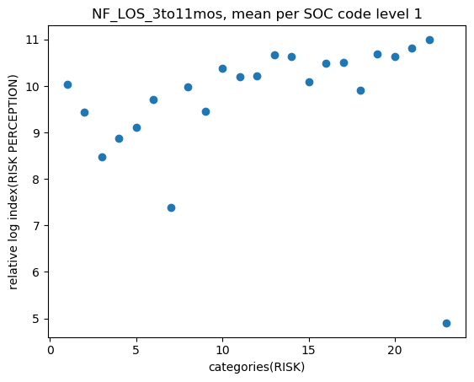
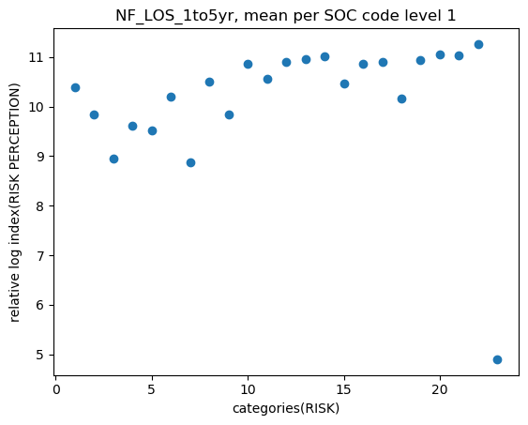
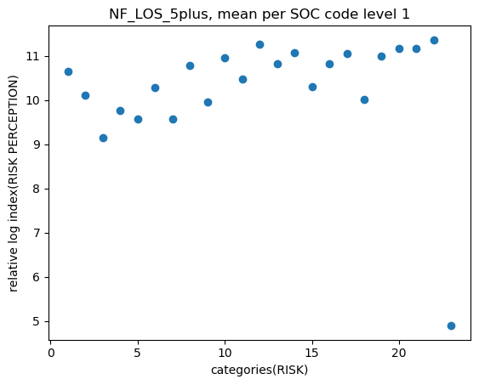
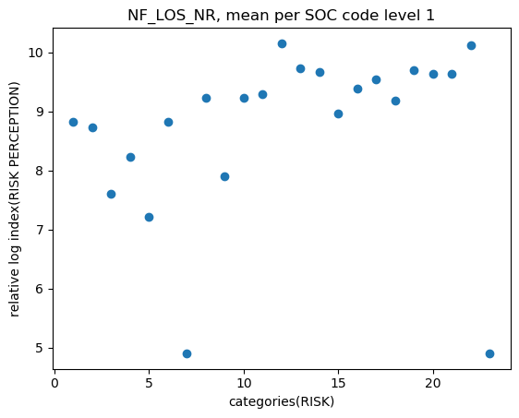
NF_LOS

Slide 42
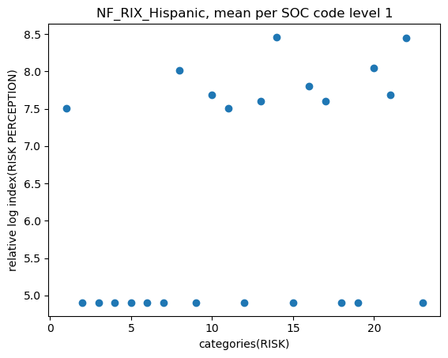
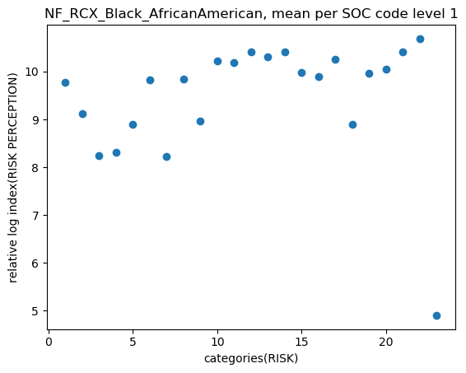
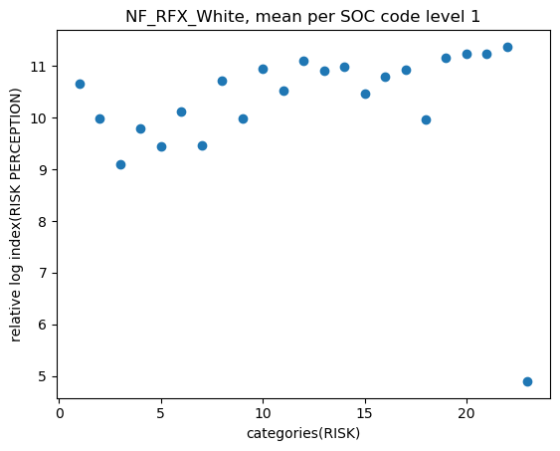
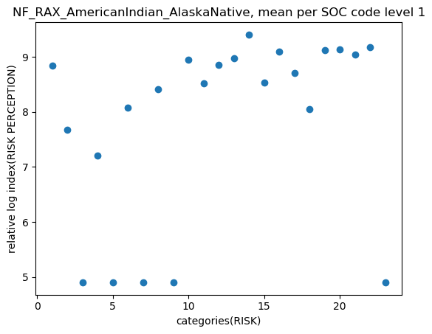
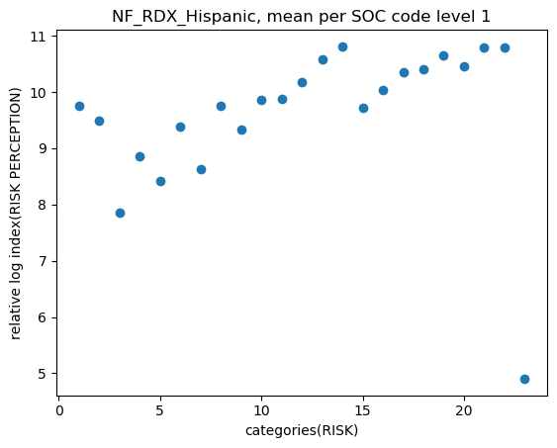
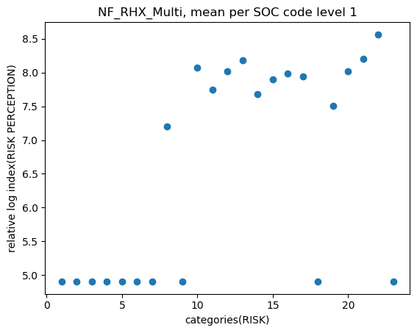
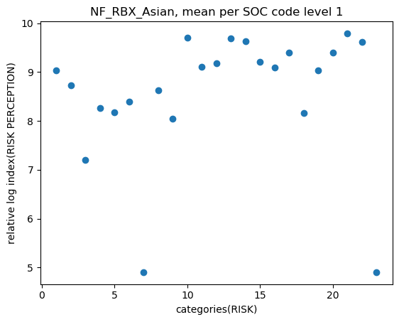
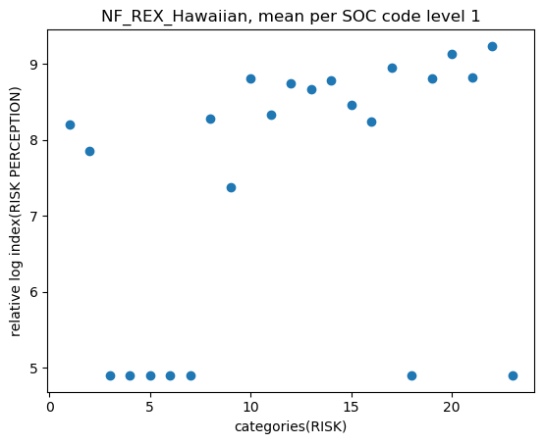
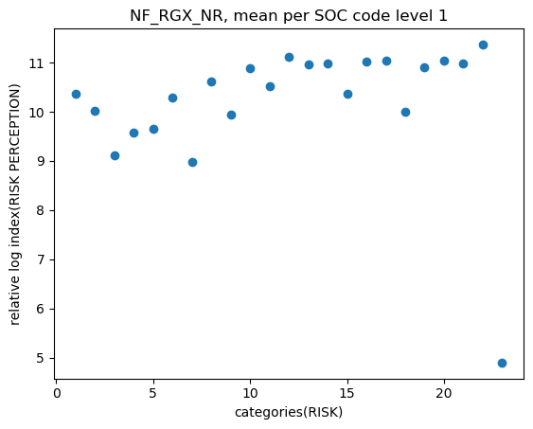
NF_R
RAX – American Indian or Alaska native
RBX – Asian
RCX – Black or African American
RDX – Hispanic or Latino
REX – Native Hawaiian or Other Pacific Islander
RFX – White
RGX – Not Reported
RIX – Hispanic and other

Slide 43
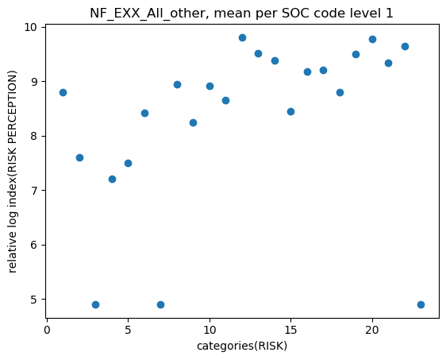
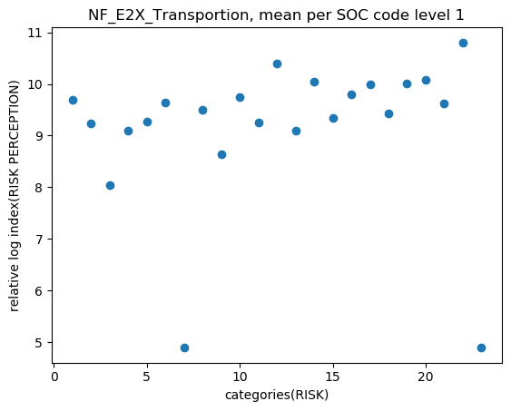
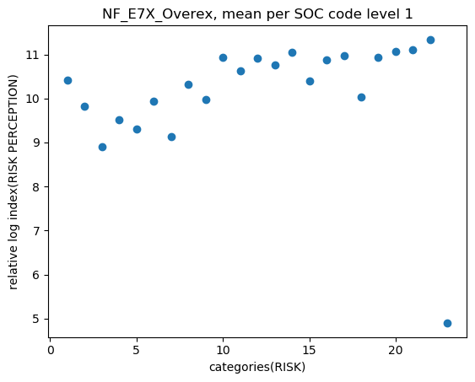
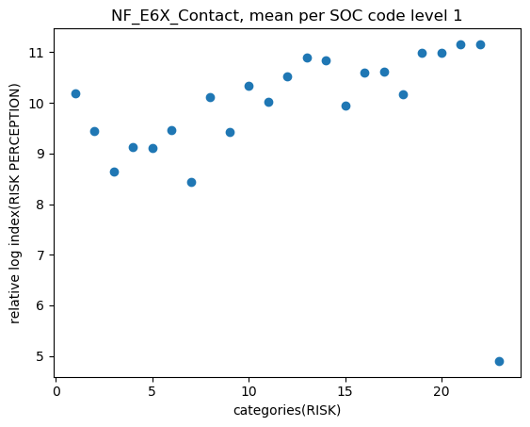
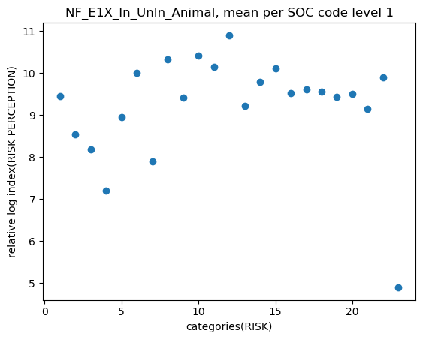
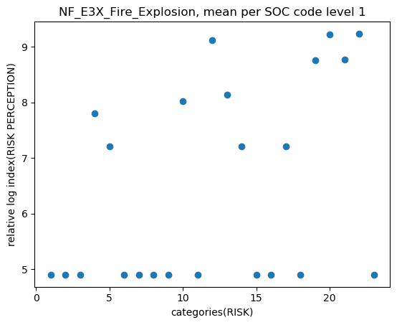
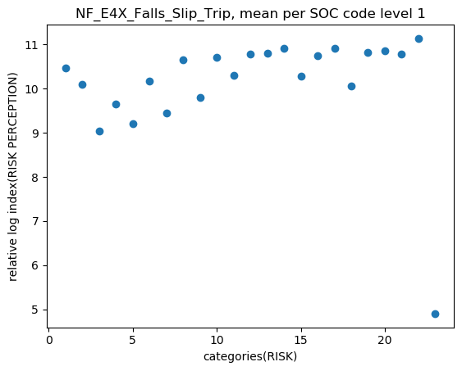
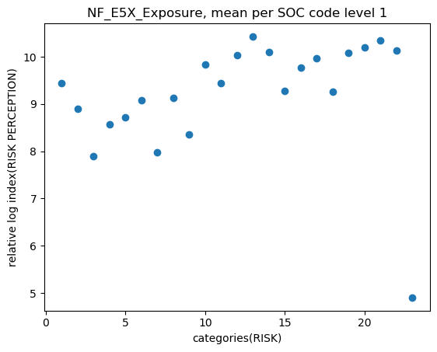
NF_EX
E1X – Violence and other injuries by persons or animal
E2X – Transportation incidents
E3X – Fires and explosions
E4X – Falls, slips, trips
E5X – Exposure to harmful substance or environments
E6X – Contact with object, equipment
E7X – Overexertion and bodily reaction
EXX – All other

Slide 44
BOX PLOTS

Slide 45
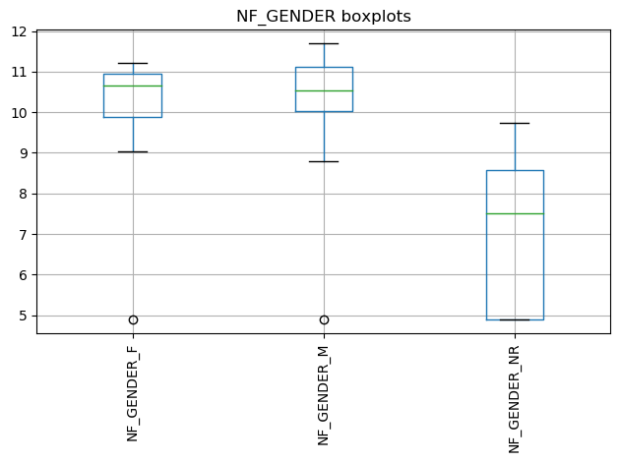
BOX PLOTS
Summary:
Females have a higher RP than males.
Not recorded (NR) distribution is missing data, but missing data exists as “recorded” data for Females and Males. Therefore, in our analysis all three were averaged so that we could get a representative distribution.

Slide 46
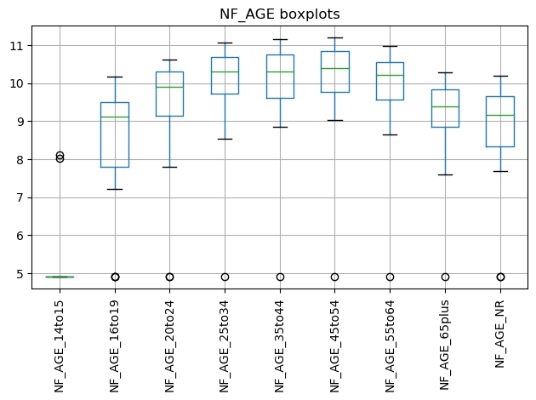
BOX PLOTS
Summary:
Age is seen to influence risk perception.
The higher the age, there higher the risk perception.
People 65 years of age or older have a decreased risk perception and a higher fatality/injury rate.
Mobility or complacency could be factors in conjunction with age.

Slide 47
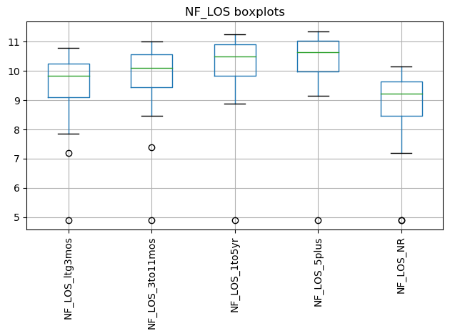
BOX PLOTS
Summary:
Length of Service impacts risk perception.
Those employees with a higher length of service have a higher risk perception and a lower fatality/injury rate.
Not recorded data is difficult to analyze but needed for averaging length of service.

Slide 48
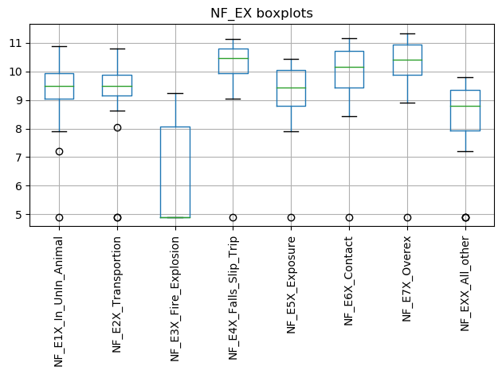
BOX PLOTS
Summary:
Slip trips and falls are the event types with the highest risk perception and the lowest fatality/injury rate. This may be due to the variety of awareness safety engineering controls and administrative controls already established in the market, such as: fall protection, safety shoe wear and regulatory requirements for surfaces in the workplace.
Explosions: From the plot below we see that most of the lower administrative jobs do not have explosion counts. However, data points #4 and #5 are corresponding to “Life, Science, Physical Occupations (labs)” and “Community Services”.

Slide 49
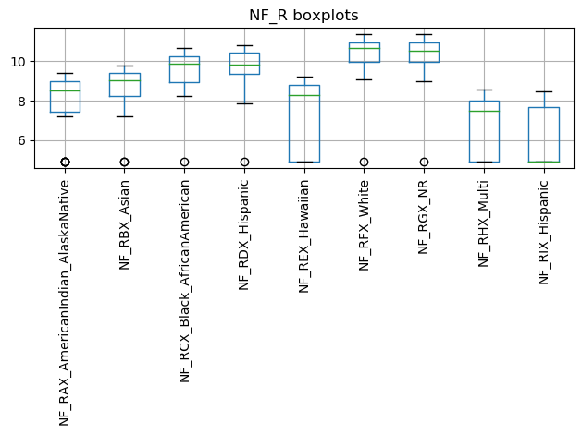
BOX PLOTS
Summary:
RFX_White appear to have the highest risk perception and the lowest fatality/injury rate.
RCX_Black and RDX_Hispanic appear to have a similar distribution with a lower risk perception.
REX_RHX_RIX have large distributions, which may need further investigation.
RAX_AlaskaNative has the worst risk perception and the highest fatality/injury rate. This could be due to extreme weather conditions and higher risk work type of occupations/industries (i.e: Oil and gas).

Slide 50
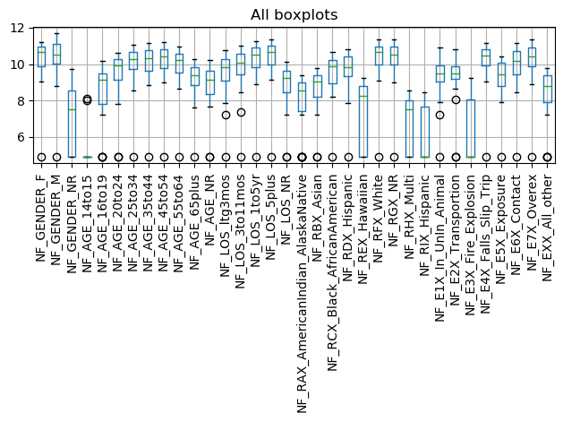
ALL_BOX PLOTS
Summary:
When compared side to side, we can see that most of the boxplot distributions are similar but slightly shifted.
From what we can see, risk perception has a temporal impact such as AGE and LENGTH OF SERVICE.
GENDER, LOS, AGE seem to consistently have good distributions and to be good candidates for linear regression.

Slide 51
PEARSON CORRELATIONS

Slide 52

CORRELATIONS
GENDER
Summary:
All green data indicates a strong pearson correlation, which values greater than 0.7 (R_{squared}).
Since GENDER_NR is missing data, it does not correlate well but it averages well.

Slide 53

CORRELATIONS
AGE

Slide 54

CORRELATIONS
LOS

Slide 55

CORRELATIONS
R

Slide 56

CORRELATIONS
E

Slide 57
AVERAGED CATEGORIES

Slide 58

Summary:
Averaged all gender results so that not recorded data could be accounted for.

Slide 59


Slide 60


Slide 61


Slide 62


Slide 63
REGRESSION

Slide 64

Summary:
The linear regression indicates a positive slope.
GENDER_AGE_LOS were averaged together to produce the dataset.
The correlation value for the linear regression was 0.7 (R_{squared}).
The positive slope shows how increasing occupational risk on the X axis produces an increase risk perception on the Y axis.
Intercept and slope values are shown in the next slide.

Slide 65


Slide 66
Summary
FI_Rate_{value} = 10 ^ (-1 * RiskPerception_{logvalue})
The occupation with the least perceived risk, Management Occupations, had the largest real fatality value (lowest perception index).
For index 0 regression:
8.73 (lower risk perception index)
1.841e-09 (largest fatality/injury)
The occupation with the most risk for fatality being Military Specific Occupations, had the smallest real fatality value (highest perception index).
For index 22 regression:
10.71 (higher risk perception index)
1.94e-11 (smallest fatality/injury )
Index 22
Index 0
risk perception
risk

Slide 67
LIMITATIONS/
RISK

Slide 68
Limitations / Potential Problems / Pitfalls and Risks
Limitations:
The study is limited to publicly available occupational injury data in the United States.
Since the injured population cannot be surveyed for risk perception, risk perception inferences will be made based on previous literature research.
There is no OSHA compliance data specific to the laboratory with the documented recordable case.
The study will not evaluate the existence of an association between compliance violations and injuries within the organization reporting the injury, illness or fatality. Therefore, based on the data available we will not be able to determine if there is an association between compliance, previous history of safety violations and the injured employee’s perception of risk.
Potential Problems / Pitfalls:
The current data interface has changed and data the process of collecting the data is now more cumbersome than before. There is no control on future changes.
The Department of Labor currently stores the data in a very fragmented way, which makes it difficult to access and consolidate for use.

Slide 69
Risks and Approvals
Risks:
It poses minimum to no risk but in turn the expected outcomes will provide public health and safety benefits as it will aim to establish an understanding on whether there is a correlation on how risk is perceived and occupational injuries in laboratory settings compared to those in manufacturing.
IRB Approval:
This study will be ran the Subject University Office of Research Integrity to collaborate that the research study is exempt via the Exempt Review process as it is a secondary data review and no people identifiers were collected, thus no identifiers will be included in the dataset for the purpose of the study.

Slide 70
REFERENCES

Slide 71
References
Cambridge University Press (2020). Definition of lagging indicator. Cambridge Advanced Learner's Dictionary & Thesaurus.
National Safety Council (2018, 2017). Injury Facts. Retrieved from: https://injuryfacts.nsc.org.
Occupational Safety and Health Administration (OSHA) (2001). Recording and Reporting Occupational Injuries and Illness, 29 C.F.R.§1904.7 Subpart C.
U.S. Bureau of Labor Statistics (2016). Current Population Survey. Census of Fatal Occupational Injuries.
U.S. Bureau of Labor Statistics (2020). Copyrights, publications, licensing and data protection. https://www.bls.gov/opub
U.S. Bureau of Labor Statistics (2020). Multi-screen data search for Injuries, Illnesses and Fatalities Data from 2011-2018. https://www.bls.gov/iif/data.htm

Slide 72
Figures
Figures
Figure 1: Graphical Representation of Hypothesis.
Figure 2: Risk Perception Model.

Slide 73
Tables
Table 1
Dependent and Independent Variables.
Table 2
Description of Independent Variables.

Slide 74
PROGRESS ACTION PLAN

Slide 75
Timeline (January – Dec 2021)
NIH
Submission
1 month
D2, D3
Committee Review
Sept-Oct’21-D2
Dec’21-D3 Tentative
0-3 months
Report Writing
Send Update.
July-Sept’21
0-3 months
Data Analysis
Aims 1 and 2
Send Update.
May-June’21
0-2 months
Draft Proposal Development
Presentation to Committee
Mar-Apr’21
0-2 months
D1r approval.
Send Update.
Data source Feasibility
Project redesign
Jan- Mar’21
Completed
On track
Late
Notes:
Data collection: 0-3 months
Data analysis for Aim 1 (A and B): 0–3 months
Data analysis for Aim 2: 0–3 months
Preparation of NIH Annual reports: 0–3 months

Slide 76
BACKUP SLIDES

Slide 77
Example Data:
More data can be found within the PLOTS directory:
The next slide shows the plot of relative fatal log10 index vs increasing SOC categories level 1. 11XXXX, 12XXXX, 13XXXX…., for the GENDER category.
The slide after that, shows the plot of relative fatal log10 index vs increasing SOC categories level 6. 110000, 111000, 111010…., for the GENDER category.
OBSERVATIONS:
Since, the relative index is a function of, y_{log} = [-1 * log10(y_{data})], then a higher relative log index value correlates to a small fatality/injury rate. Since the categories on the x axis are ranked from left to right with increasing job risk. We can see a positive slope, that indicates that people with a higher perception of risk have a lower fatality rate.
We also believe that we see a relationship of injury count, fatal count, and soc_code combination. Therefore, we should be able to predict a fatality count given an soc_code and injury count.
Any other suggestions as to what other potential statistical measurements we can perform, would be appreciated?
https://github.com/ehsintegration/yfd-phd-bls-data/tree/master/PLOTS

